Slide 1
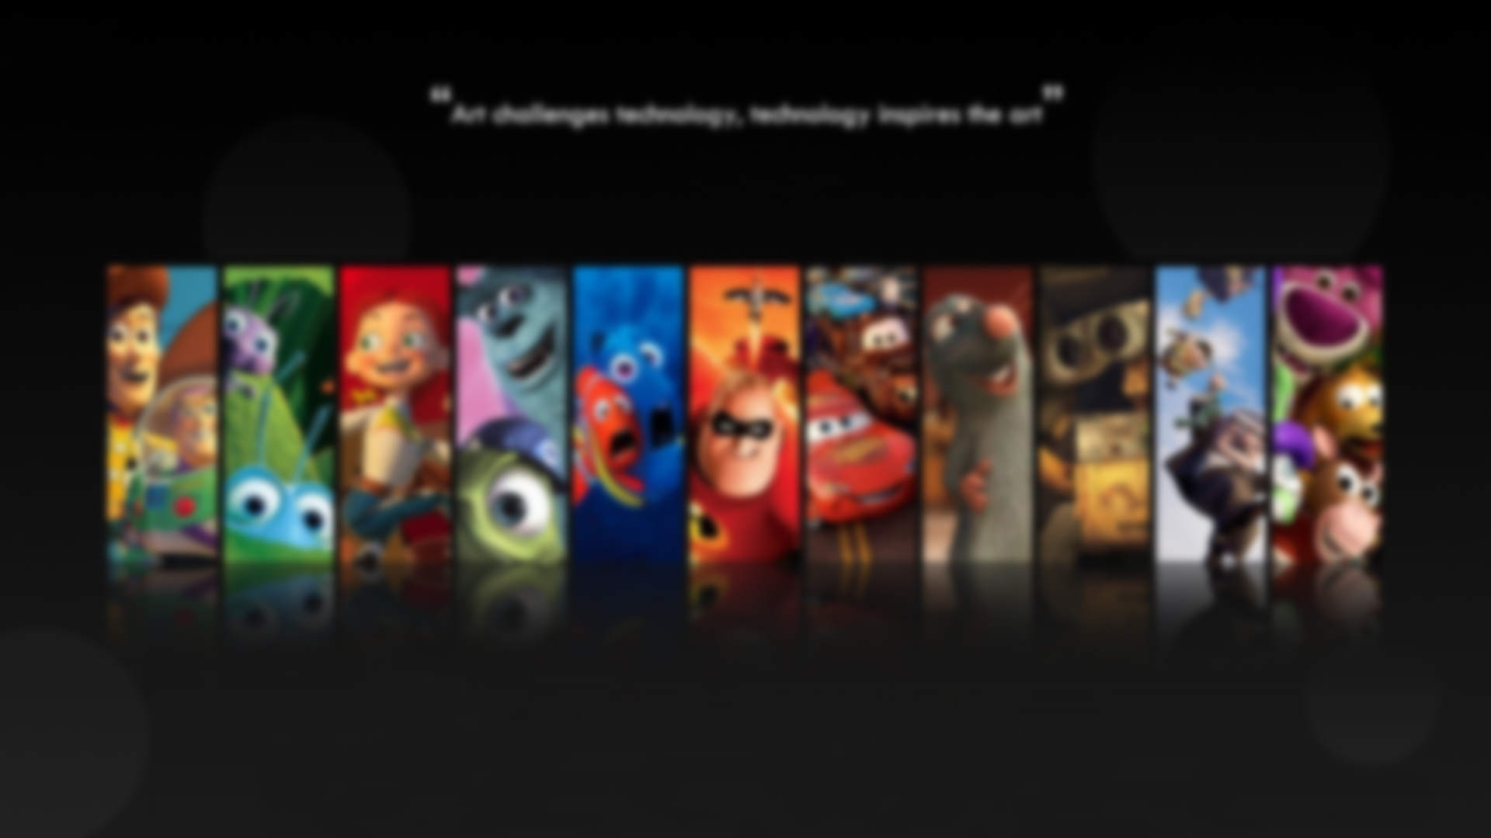

Slide 2
Project Details
Project Team ID: VEDANSH SHINDE
Guide Name: DR. NOOR MOHD.
Section: A (3rd sem) B.Tech CSE
Roll number: 71

Slide 3
Project Details
Project Team ID: VEDANSH SHINDE
Guide Name: DR. NOOR MOHD.
Section: A
Roll number: 71

Slide 4








TOPICS COVERED

Slide 5

INTRODUCTION

Slide 6


INTRODUCTION
The rapid growth of digital platforms has completely transformed how we consume content, especially in the entertainment industry. Platforms like Netflix and Amazon Prime now offer massive catalogues of movies, TV shows, and documentaries. While this incredible variety gives us access to more content than ever before, it also comes with a downside: decision fatigue. With so many options, it can feel overwhelming to pick what to watch, leaving users frustrated and sometimes even disengaged.

Slide 7
PROBLEM STATEMENT
With the vast number of movies available on streaming platforms, users often struggle to find content that matches their preferences. Existing systems, like collaborative filtering, can face issues such as the cold start problem for new users. This project aims to build a Movie Recommendation System using Content-Based Filtering that recommends movies based on their inherent features (e.g., genre, director, cast, plot). By analyzing movie similarities, the system will provide personalized recommendations without relying on user interaction data, enhancing the discovery of relevant movies.

Slide 8

METHODLOGY

Slide 9

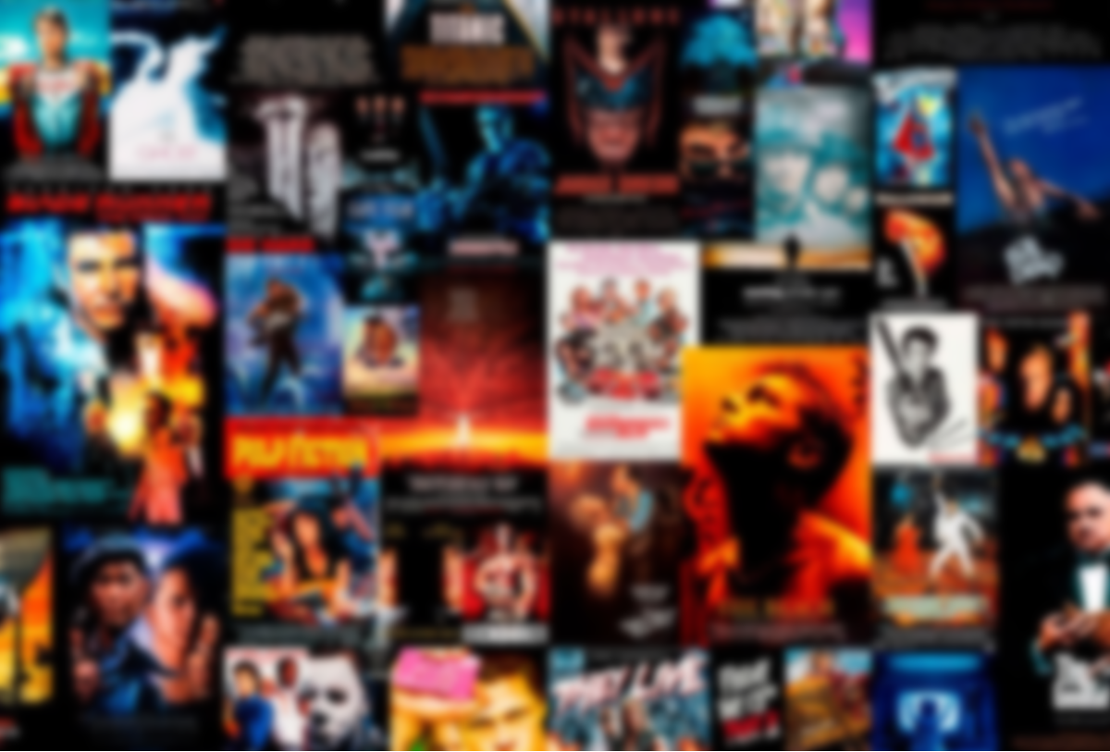
METHODLOGY
The methodology outlines the structured approach adopted to develop the Movie Recommendation System..

Slide 10
KEY PREPROCESSING TASKS INCLUDED:
1. Handling Missing Values:
Missing values in essential columns such as genres and cast were addressed by filling them with placeholders. Rows were removed only when critical information was unavailable,
2. Data Cleaning:
Text fields, such as movie overviews and taglines, were stripped of special characters, HTML tags, and extra spaces. This cleaning improved consistency and enhanced the quality of text-based features.
3. Unified Feature Vector:
A unified feature vector was created by combining all selected attributes. For instance, genres, cast, and keywords were merged into a single vector for each movie, ensuring comprehensive representation.

Slide 11
Cosine Similarity:
Cosine similarity is a popular method for measuring how similar two things are by looking at their direction in a multi-dimensional space. Imagine you're trying to figure out how similar two items are — like movies, books, or products. Cosine similarity helps by comparing them based on their features or characteristics
The idea behind it is simple: it calculates the cosine of the angle between two vectors (which represent the items). If the angle is small, it means the items are very similar, and you'll get a score close to 1. If they’re completely different, the angle will be large, and the score will approach -1. If the items are totally unrelated, meaning they don’t overlap at all, the cosine similarity will be 0, indicating they’re orthogonal or unrelated.
This measure is particularly useful in recommendation systems, where the goal is to suggest items that are most similar to what a user has liked before, based on shared features. It helps ensure that the suggestions are relevant and closely related to the user's preferences.

Slide 12
Conceptual Explanation for Movie Recommendations
In the context of a movie recommendation system, the vectors represent the feature attributes of movies, such as genre, overview, director, and cast. Each movie is represented as a high-dimensional vector, where each dimension corresponds to a specific characteristic (e.g., action, romance, or rating).
For instance, Movie A might have a vector representation that emphasizes action (0.8), thriller (0.6), and a high user rating (0.9), while Movie B might have a vector emphasizing similar dimensions but in different proportions, such as action (0.7), thriller (0.7), and user rating (0.85). By calculating the cosine similarity between these two vectors, the recommendation system can quantify how similar these two movies are in terms of their features.

Slide 13

RESULTS

Slide 14

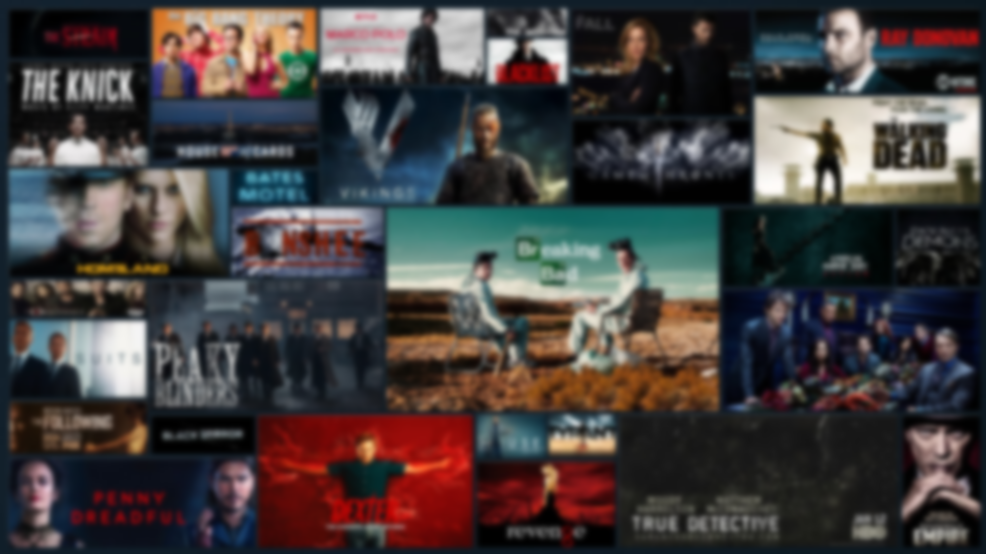
RESULTS
In this section, we summarize the outcomes of the Movie Recommendation System, focusing on how well it worked, challenges faced, and how the choice of cosine similarity contributed to the system's effectiveness.

Slide 15
EFFECTIVENESS OF THE RECOMMENDATION SYSTEM
Relevance of Recommendations:
The system did a great job of recommending movies that matched users' tastes. By using features like genre, overview, cast, and crew, it suggested films similar to the ones users had enjoyed in the past. For example, if a user liked action and thriller movies, the system recommended more films within those genres, which kept the suggestions relevant and accurate.
Handling the Cold-Start Problem:
The cold-start problem, where new users or movies struggle to get good recommendations due to limited data, was well-handled. Since the system relies on movie attributes (like genre and cast) instead of user ratings, even new movies and new users received quality suggestions right from the start.
Diversity of Recommendations:
While the system was great at recommending similar movies, it sometimes focused a little too much on a narrow range of genres or themes, especially if a user liked a very specific type of movie.

Slide 16
CHALLENGES ENCOUNTERED
Data Quality and Missing Information:
A key challenge was dealing with incomplete or missing data, especially in critical areas like movie genre or cast. While missing values were handled by using placeholders or removing rows with essential missing information, this occasionally meant some good movies were excluded from the recommendations.
Feature Selection and Representation:
Choosing the right features to represent each movie was another challenge. Attributes like genre, cast, and crew were straightforward, but text-based features, like movie overviews, required additional processing to extract useful information. Ensuring that these features accurately represented the movies was essential to making good recommendations.

Slide 17
How Cosine Similarity Worked:
Cosine similarity was an excellent choice for comparing movies based on their feature vectors. It measured how similar two movies were by looking at the angle between their feature vectors, which normalized for differences in the number of features, allowing the system to compare movies accurately even when they had varying amounts of data.
Advantages:
Cosine similarity’s biggest advantage was its simplicity and efficiency. It worked well for movies with different feature sets, ensuring that even if one movie had many attributes and another had only a few, they could still be compared meaningfully. Its straightforward computation also made it well-suited for large datasets.
Limitations:
The main drawback of cosine similarity is that it doesn’t take into account user-specific preferences. It focuses only on movie features, so it might miss nuances in a user’s personal taste. For example, two movies might share similar features but appeal to different users based on their individual preferences. Incorporating user behavior through a hybrid model, combining both content-based and collaborative filtering, could help overcome this limitation and provide more personalized recommendations.

Slide 18
CONCLU
SION

Slide 19


CONCLU
SION
The Movie Recommendation System created for this project effectively helped users discover movies they’d love by offering personalized and relevant suggestions. Using content-based filtering and cosine similarity, the system analyzed movie features like genre, overview, cast and crew to match users with films that aligned with their preferences. It also successfully overcame the cold-start problem, making it useful for both new users and lesser-known movies.
While the system performed well overall, there were some challenges, such as handling missing data, choosing the right features, and optimizing performance. These obstacles provided valuable lessons and pointed to areas where the system could be further refined.

Slide 20
FUTURE WORK
Looking ahead, there are several ways to make the Movie Recommendation System even better:
1.Hybrid Recommendation Approach:
Combining content-based filtering with collaborative filtering would bring the best of both worlds. This would allow the system to not only consider movie features but also user preferences, resulting in more accurate and diverse recommendations.
2.Incorporating User Behavior:
Including more personalized data, like a user’s viewing history and ratings, would make the system smarter. By learning from a user's past choices, the system could suggest movies that are even more tailored to their unique tastes.
Improved Data Handling:
To overcome issues like missing data, more advanced techniques could be used to fill in gaps or work with larger, more complete datasets. This would ensure that all relevant movies are considered for recommendations.
4.Scalability and Performance Optimization:
As the system grows, it could slow down when calculating similarities. To keep it fast and efficient, using methods like approximate nearest neighbor search or more advanced dimensionality reduction techniques would help speed things up and ensure scalability.

